Slide 1
GRID2DEMAND: A tool for generating zone-to-zone travel demand based on grid zones Roy Luo, Xuesong (Simon) Zhou at ASU Presented at RTA Training Cycle 2024
Notes:
Hi everyone! Thanks for the invitation!
I’m so happy to share with you about the quick demand generation tool, Grid2demand.

Slide 2
Problems to Solve (1)
Trip Generation Using Socioeconomic and Demographic Data
Problem Statement: Effective trip generation relies on accurate socioeconomic and demographic data such as household size, income, and employment. Incorrect or missing data can lead to inaccurate demand forecasts.
Problems to Solve:
How to efficiently gather and integrate accurate demographic and socioeconomic data to enhance trip generation estimates.
Ensuring the consistency and availability of reliable trip rates from diverse data sources.

Slide 3
Problems to Solve (2)
Handling Different Land Use Types in Trip Generation
Problem Statement: Trip generation involves estimating trips from different land use types (e.g., residential, commercial, recreational). Accurate trip production and attraction rates are essential for different land use categories.
Problems to Solve:
How to assign accurate production and attraction rates to various land use types, especially when Point of Interest (POI) data does not follow a consistent standard.
Ensuring that grid cells and land use categories reflect the real demand from each zone in a city.

Slide 4
Problems to Solve (3)
Generating Demand with Customized Trip Purposes
Problem Statement: Different trip purposes (e.g., home-based work, home-based other, non-home-based) require tailored friction factors and trip generation rates.
Problems to Solve:
How to assign and calibrate friction factors for specific trip purposes accurately, especially when default values do not align with local conditions.
Providing users the flexibility to customize trip purposes and generation rates without compromising the accuracy of the demand matrix.

Slide 5
Additional Features
Visualizing OD Demand and Network Files for Planning
Problem Statement: Visualizing demand and network data is critical for effective planning and decision-making. However, ensuring compatibility between data formats and visualization tools like QGIS can be challenging.

Slide 6
Potential Use in RTA at Dubai (1)
Optimizing Public Transit Route Planning
Use Case: Using demand forecasting tools, RTA engineers can analyze and predict travel patterns to optimize public transit routes across Dubai. By understanding high-demand zones and analyzing passenger movements between different areas, RTA can enhance bus routes, metro schedules, and the integration of multimodal transportation.
Benefit: This enables more efficient use of public resources, reduces wait times, and improves service coverage in areas with high demand, thereby enhancing commuter satisfaction and reducing congestion.

Slide 7
Potential Use in RTA at Dubai (2)
Identifying and Mitigating Traffic Bottlenecks
Use Case: Traffic engineers can use OD demand matrices to identify recurring traffic bottlenecks and analyze peak-hour congestion patterns across Dubai’s major roads and highways. By simulating different scenarios, such as road expansions or signal timing changes, engineers can propose strategies to alleviate congestion.
Benefit: Reduces delays and improves the overall flow of traffic during rush hours, especially in key commercial and residential areas.

Slide 8
Introduction and Background Knowledge
Four step transportation forecasting
1. Trip Generation
How many trips enter or leave a zone/traffic-analysis-zone (TAZ)
Grid2demand
2. Trip Distribution
How many trips from each zone/TAZ end in all zones/TAZs
3. Mode Choice
Which travel mode is used (e.g., vehicle, transit, or walk) to complete those trips
4. Traffic Assignments
Vehicles/traffic flow to different paths during travel
Calculation of Performance Measures
Notes:
Generally, to understand the decision-making process, planners have implemented the four-step urban planning process. On the left-hand side in this slide, the flowchart shows the typical four step process in transportation planning. Each step estimates 1., estimates 2., estimates 3., and lastly distribute 4. In this sequential process manner, planners can consider travel demand and the characteristics of transportation network, measuring optimal transportation cost.
To avoid the data inconsistency between travel demand and built network environment, we introduce grid2demand package to match the two dimensions efficiently. Particularly, this package helps users generate the first two stages (trip generation and trip distribution).

Slide 9
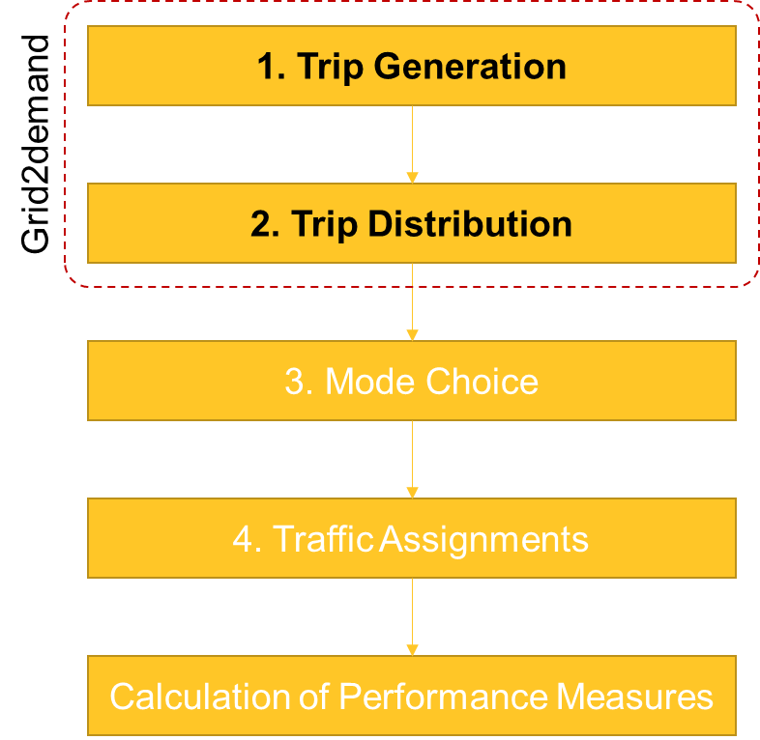
Trip Generation
Four step transportation forecasting
1. Trip Generation
First step in the four-step model
Socio-demographic and economic data
Household size/income
Gender/age
Trips are grouped by different purposes
Home-based work (HBW)
Home-based other (HBO)
Nonhome-based (NHB)
Notes:
First, let’s consider the first stage: trip generation. Using socio-demographic and economic data (household size, income), we estimate the number of person trips originating in or destined for a particular traffic analysis zone.
A person trip involves a single person leaving from an origin and arriving at a single destination, and each trip has a classification/purpose based on typical classification such as home-based-work (HBW), home-based-other (HBO), and non-home-based (NHB). To generate trips in our package, we use trip rates given by point of interest ( the default trip generation rates refer to ITE Trip generation manual).

Slide 10
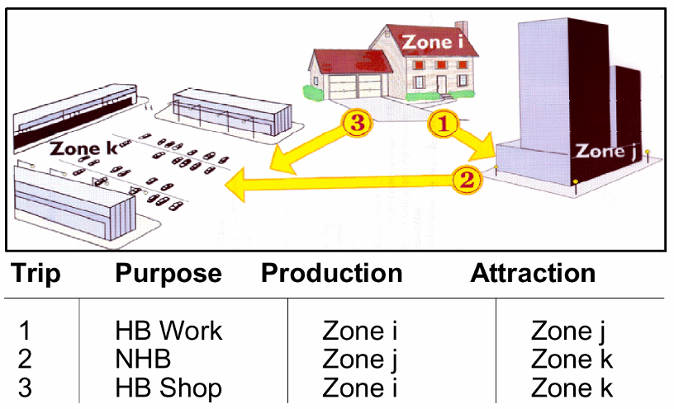
Trips (Production/Attraction)
Trip production:
Home end of a home-based trip
Beginning of a non-home-based trip
Trip attraction:
Non-home end of a home-based trip
Destination of a non-home-based trip
Notes:
In trip-based transportation planning, trip productions/attractions are modeled by a function of population and explanatory variables, which can be obtained from household survey data. For instance, productions in home-based are modeled by the total population and the number of households, and attractions in non-home based (e.g., office) can be generated by the function of the number of households and the number of employees.
Grid2demand uses the trip rates from POI, computing trip production, and trip attraction. Then, with the information, we move on to the second stage.

Slide 11
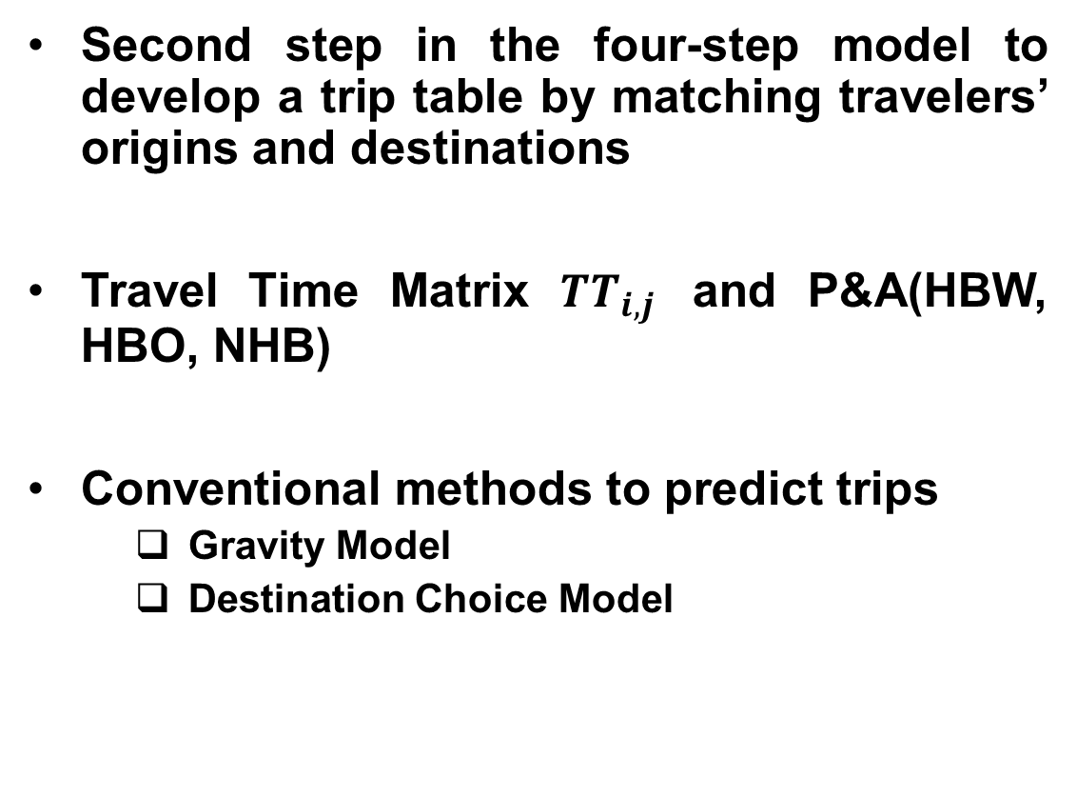
Trip Distribution
Four step transportation forecasting
Second step in the four-step model to develop a trip table by matching travelers’ origins and destinations
Travel Time Matrix $TT_{i,j}$ and P&A(HBW, HBO, NHB)
Conventional methods to predict trips
Gravity Model
Destination Choice Model
2. Trip Distribution
Notes:
This second step generates a trip table to distribute travelers’ origins and destinations in a matrix form. To disaggregate the zone-based production/attraction trips, impedance by travel time will be used. For instance, travelers would select the lower impedance when moving from origin to destination. There are two conventional methods to form the trip distribution matrix; gravity model and destination choice model. In this package, we select the gravity model.

Slide 12
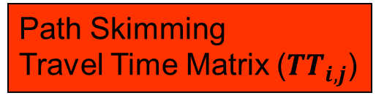
Origin-Destination Matrix
Trip Generation
P & A (HBW)
Path Skimming
Travel Time Matrix ($TT_{i,j}$)
TAZ | Productions | Attractions
1 | 234 | 1080
2 | 76 | 531
3 | 602 | 76
4 | 432 | 47
5 | 472 | 82
TAZ | 1 | 2 | 3 | 4 | 5
1 | 2 | 12 | 8 | 15 | 21
2 | 6 | 3 | 9 | 23 | 14
3 | 20 | 7 | 5 | 10 | 25
4 | 12 | 18 | 8 | 5 | 17
5 | 24 | 19 | 23 | 15 | 6
Trip Distribution
TAZ | 1 | 2 | 3 | 4 | 5 | Productions
1 | 199 | 2 | 15 | 2 | 16 | 234
2 | 35 | 25 | 12 | 3 | 1 | 76
3 | 147 | 324 | 38 | 31 | 62 | 602
4 | 330 | 90 | 4 | 6 | 2 | 432
5 | 369 | 90 | 7 | 5 | 1 | 472
Attractions | 1080 | 531 | 76 | 47 | 82 | 1816
OD matrix
Notes:
By using the trip generation and the travel time matrix, Gravity model distributes production/attraction trips (i.e., Origin-destination matrix). As you can see, when summing up the TAZ column 1 in OD matrix, the total number of trips is matched with the number of the trip attraction in TAZ 1.

Slide 13
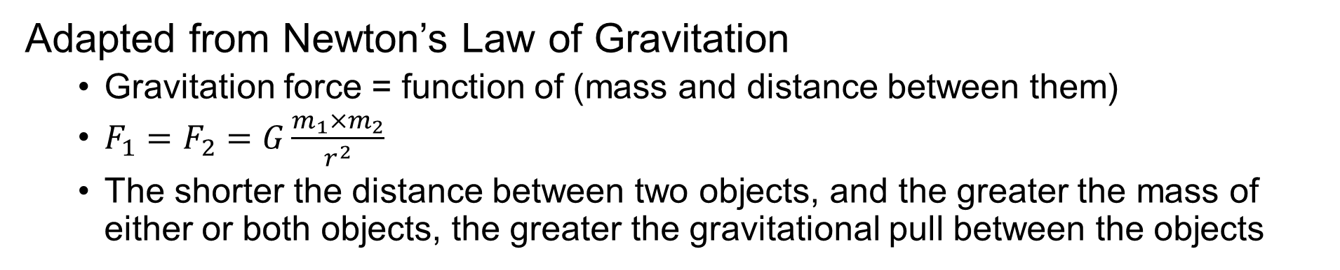
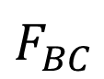
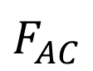
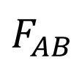
Gravity Model
Adapted from Newton’s Law of Gravitation
Gravitation force = function of (mass and distance between them)
$F_{1}=F_{2}=G\frac{m_{1}×m_{2}}{r^{2}}$
The shorter the distance between two objects, and the greater the mass of either or both objects, the greater the gravitational pull between the objects
$$F_{AB}$$
B
A
$$F_{BC}$$
$$F_{AC}$$
C
Notes:
The principle of gravity model is adapted from newton’s law of gravity. Basically, if the shorter the distance between two objects, the greater the gravitational pull between the objects. or If the greater the mass of either or both objects, the stronger the gravitational pull between them. As illustrated in the figure, we can see the stronger gravitational force between A and B than the force of gravity between A and C.

Slide 14
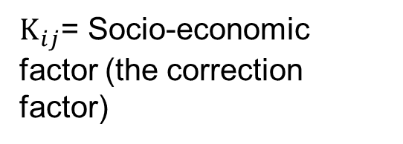
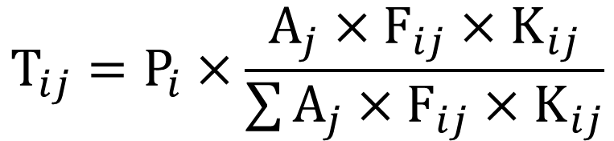
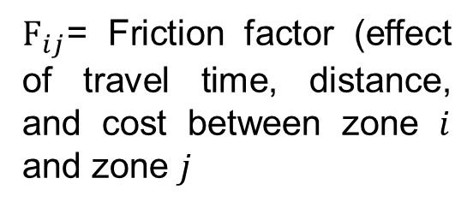
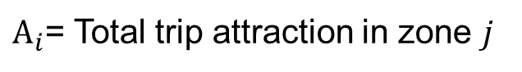
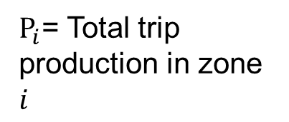
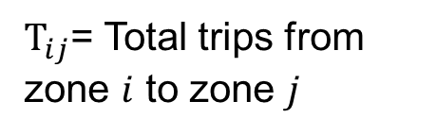
Gravity Model for OD matrix
Determine the number of trips between “from” TAZ_{i} to “To” TAZ
$A_{i}$= Total trip attraction in zone $j$
$$T_{ij}=P_{i}×\frac{A_{j}×F_{ij}×K_{ij}}{\sum{A_{j}×F_{ij}×K_{ij}}}$$
$K_{ij}$= Socio-economic factor (the correction factor)
$T_{ij}$= Total trips from zone $i$ to zone $j$
$F_{ij}$= Friction factor (effect of travel time, distance, and cost between zone $i$ and zone $j$
$P_{i}$= Total trip production in zone $i$
Notes:
For the OD matrix, a typical gravity model to calculate zone-to-zone demand volume is formulated as follows.

Slide 15
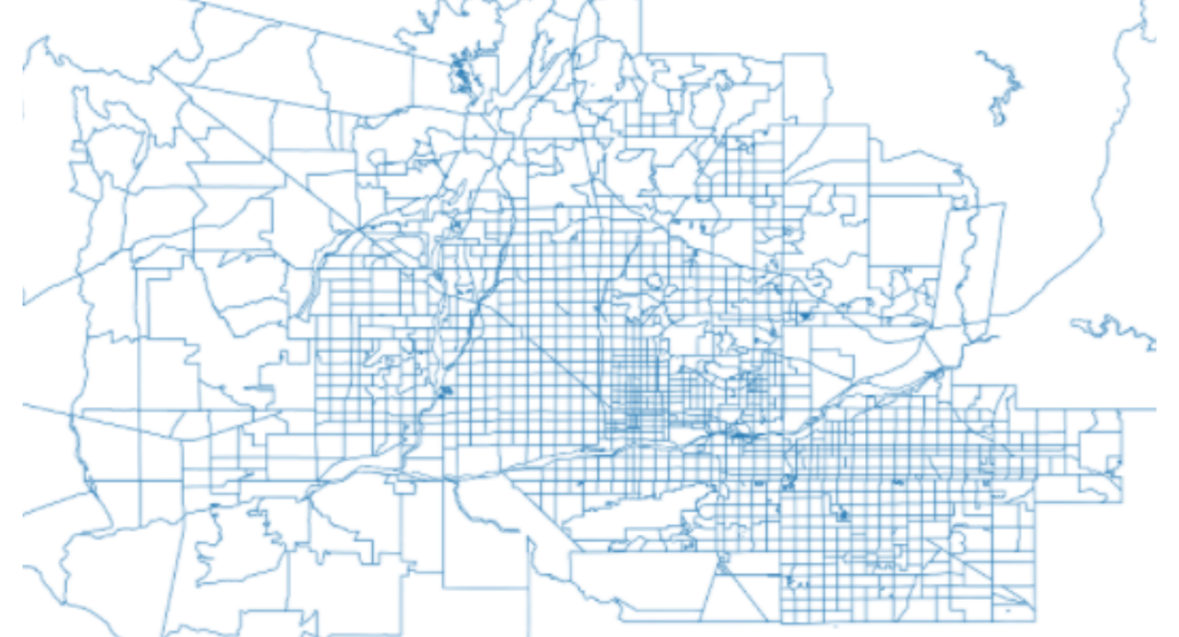
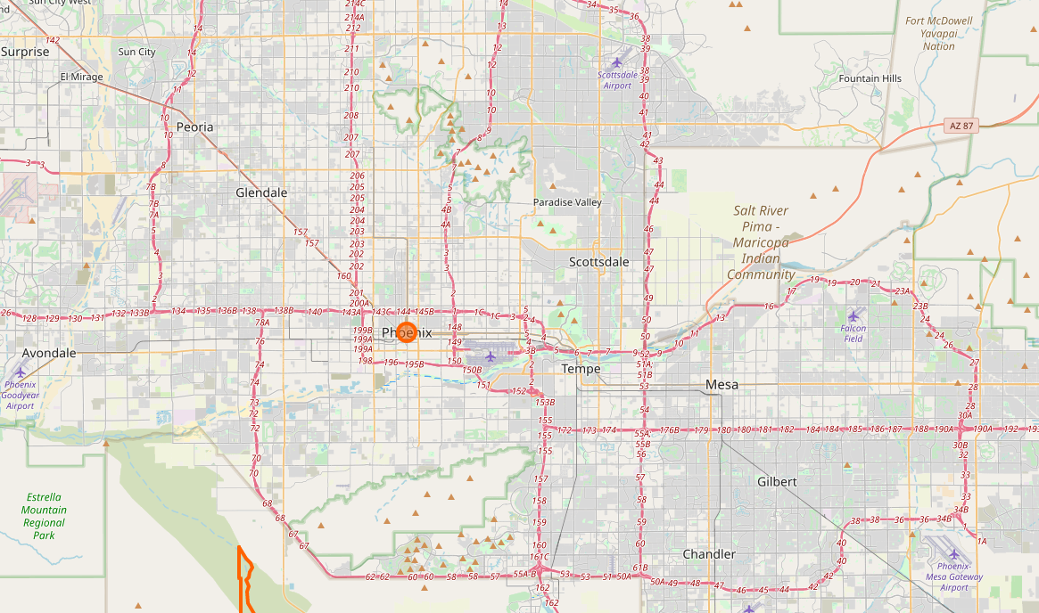
GRID2DEMAND Framework
Traffic Analysis Zone
Mapping
Network
Notes:
This background knowledge is coded in the grid2demand package, and users automatically generate the two sequential steps and take advantage of mapping traffic analysis zone and network efficiently.

Slide 16
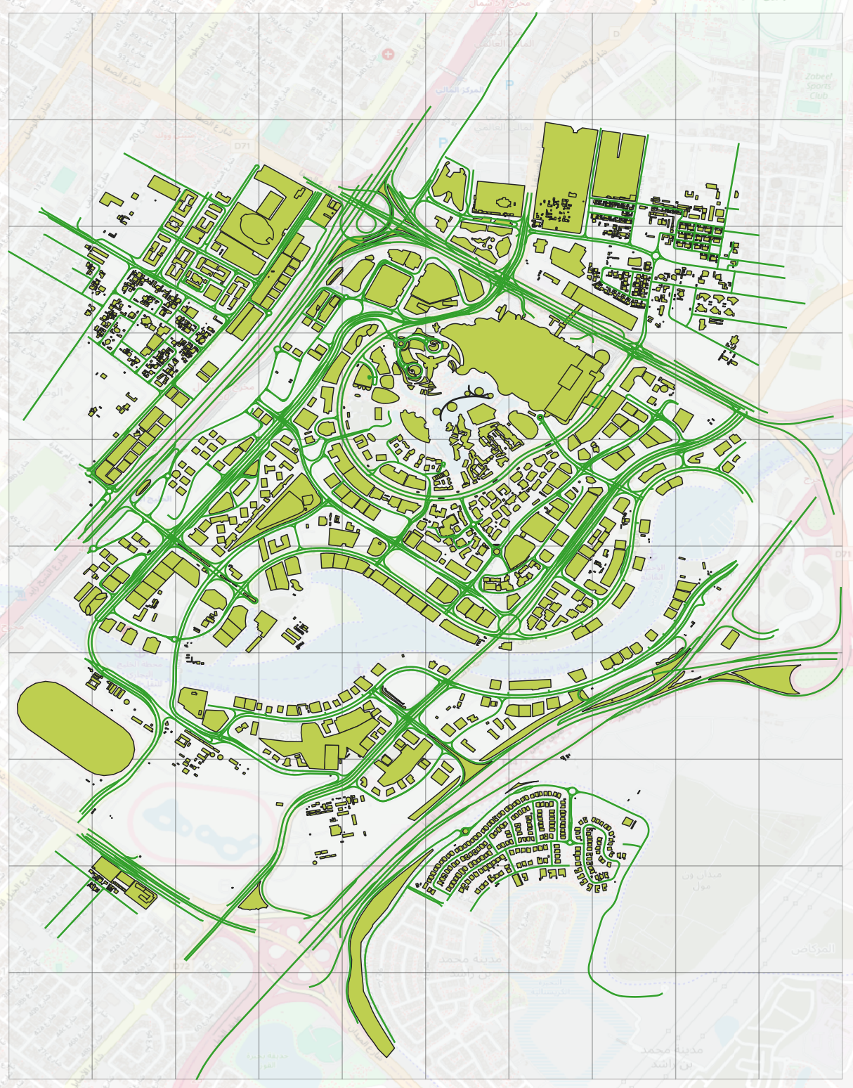
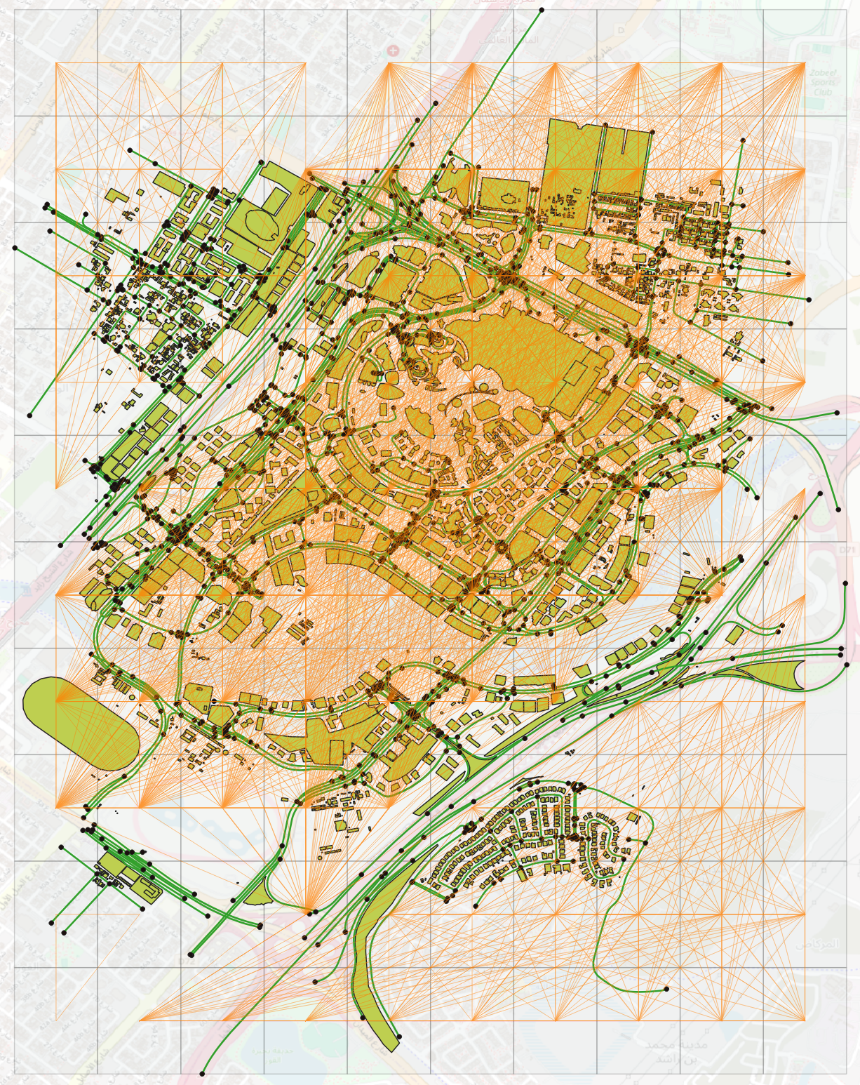
Dubai Downtown Area
Notes:
This background knowledge is coded in the grid2demand package, and users automatically generate the two sequential steps and take advantage of mapping traffic analysis zone and network efficiently.

Slide 17
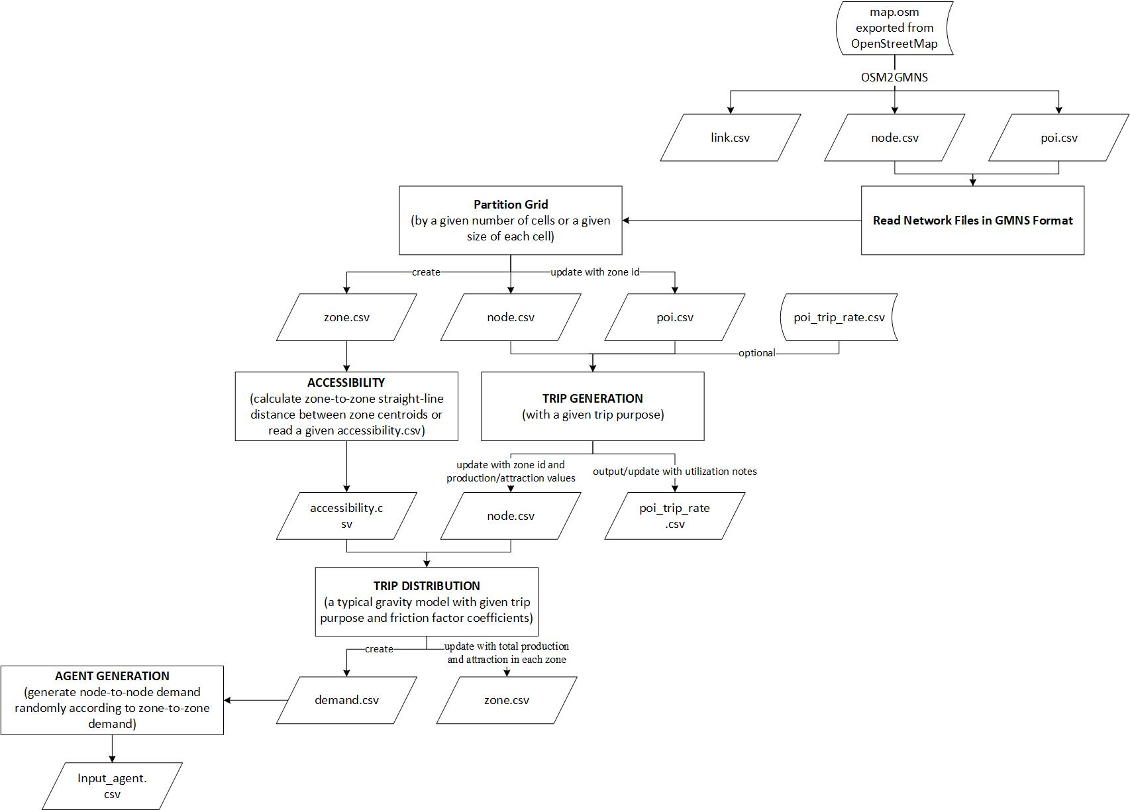
INPUT files
Network files in GMNS format can automatically generated by OSM2GMNS tool.
POI data may need manual modification, because building types extracted from OpenStreetMap do not follow a land use type standard.
(Optional) Users can give a customized trip rates table in advance or edit the default table.
Output demand and agent files are aligned with standard travel models for static and dynamic transportation management and planning.
Notes:
Let’s look at the framework.
Firstly, network files including POI data are prepared by osm2gmns. The network files and poi trip rate table are the input. It’s OK if there’s no trip rate table.
Then based on four-step travel model, 1) we partition zones by grid, 2) forecast production and attraction for each POI node, boundary node and residential node, 3) and calculate zone-to-zone accessibility.
Finally, apply a classical gravity model to perform trip distribution and randomly get node-to-node demand for assignment.
The output demand and agent files are aligned with standard travel models for static and dynamic transportation management and planning.

Slide 18
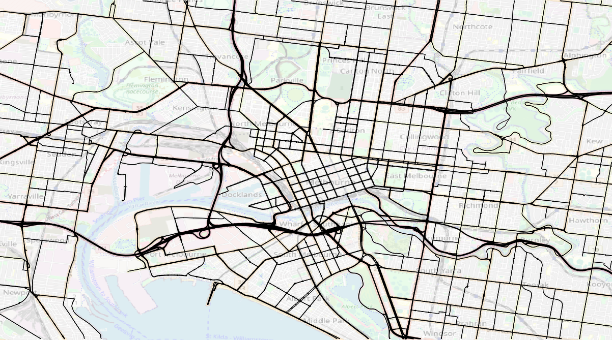
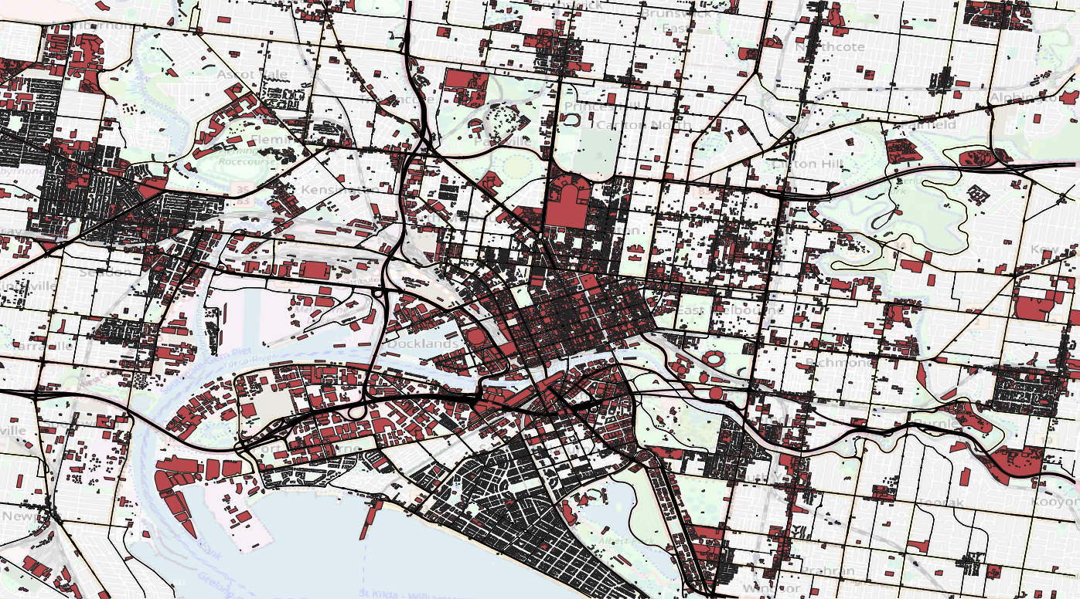
Step 1: Network Preparation
Export a network file from OpenStreetMap.
Use OSM2GMNS tool to convert the network from OpenStreetMap to a routable transportation network with .csv files in standard GMNS format. (https://github.com/asu-trans-ai-lab/OSM2GMNS)
Road network
Road network with Point Of Interest (POI)
Notes:
The first step to apply grid2demand is network preparation.
The .osm file of the area of interest can directly exported from OpenStreetMap. And use osm2gmns to convert the network into a routable .csv files in GMNS format.
POI data may need manual modification, because building types extracted from OpenStreetMap do not follow a land use type standard.

Slide 19
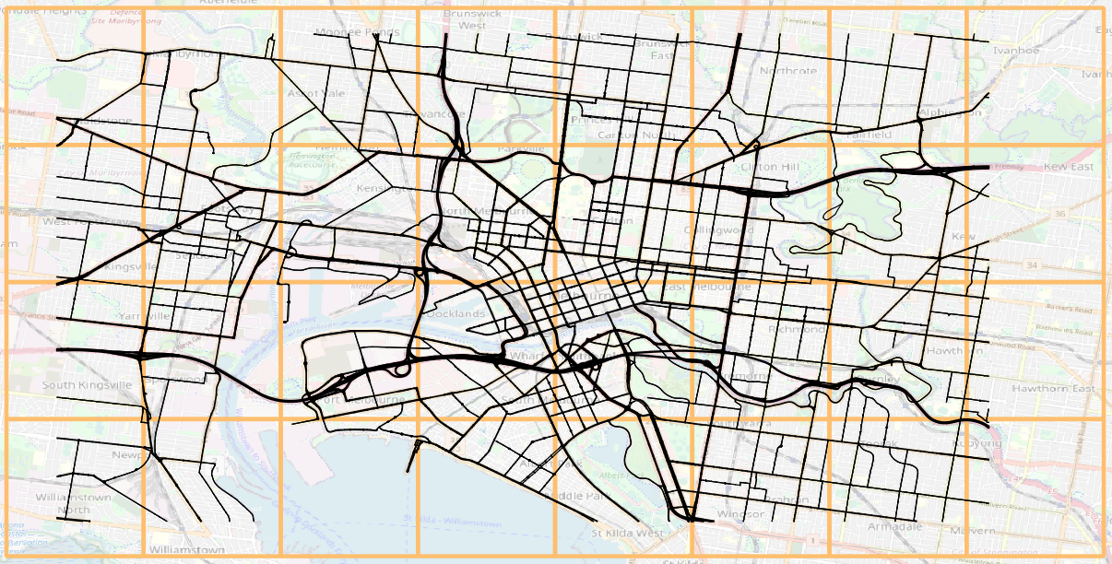
Step 2: Import GRID2DEMAND and read the network data
Step 3: Partition Grid Into Grid Cells
Grids can be automatically generated by a given number of grid cells or cell's width and height in meters.
Notes:
Then, import grid2demand. Input the number of grid cells or cell size you’d like. Grids can be automatically generated.

Slide 20
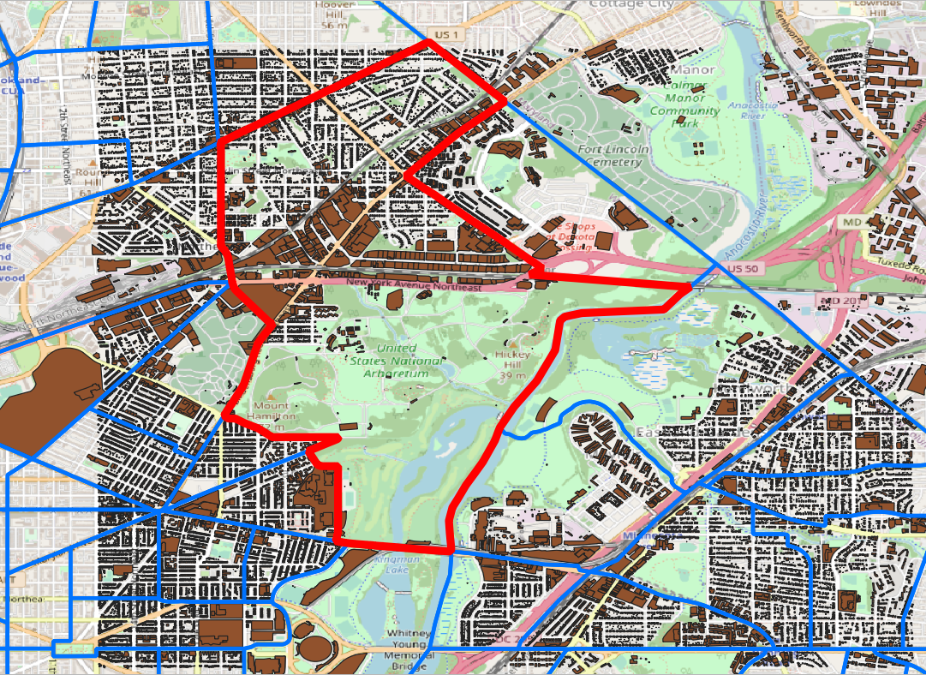
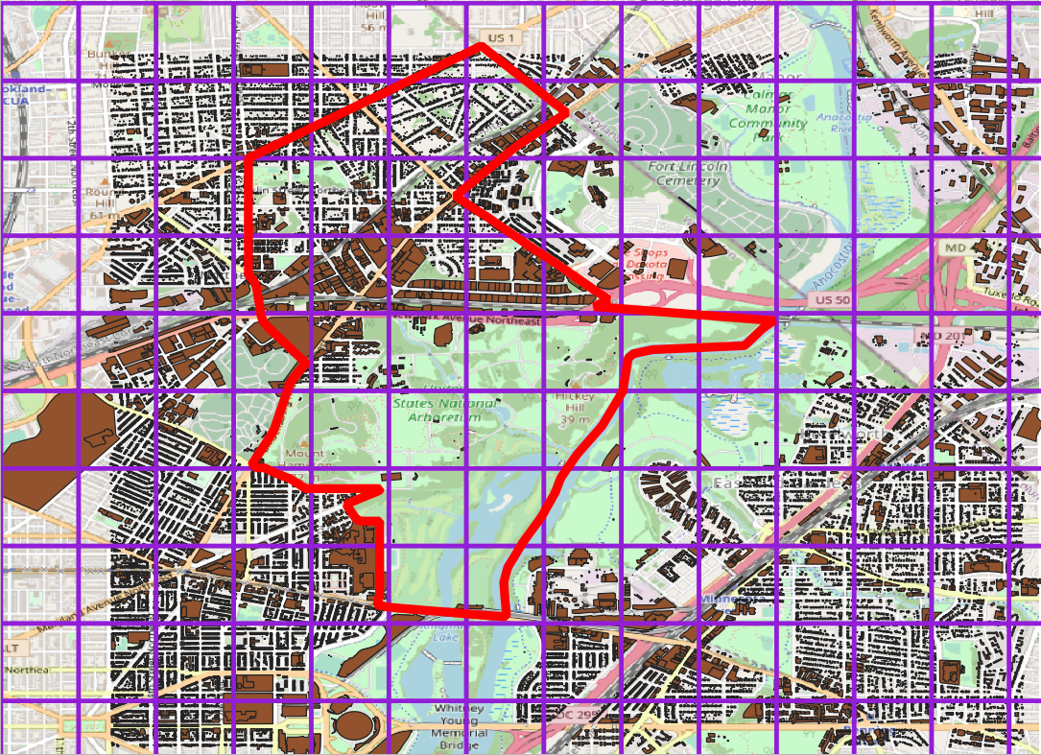
Why grid zones?
TAZ based on census tracts
Grid zones
Census tract
Grid cell
Land use is ignored in TAZs. The spatial biases may deteriorate the accuracy of travel demand.
Trip generation directly comes from activity nodes, which is aggregated in grid zones. Smaller grid, more accurate demand.
Zones partitioned by grids could reduce spatial biases.
Notes:
You may ask why we partition zones by grid.
Let’s see the left side first. The red boundary is a census tract. If we directly regard it as a traffic analysis zone, most travel demand come from the north side. And TAZs have different shapes and sizes. Such spatial biases may deteriorate the accuracy of travel demand.
However, zones partitioned by grids with same size could reduce the spatial biases. Trip generation directly comes from activity nodes aggregating in each grid.

Slide 21
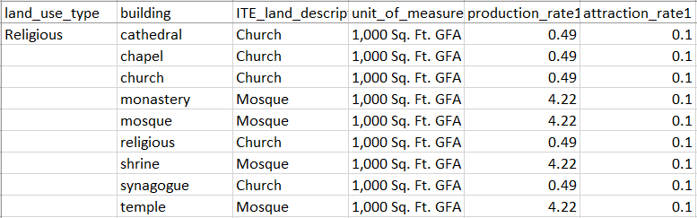
Step 4: Get production/attraction rates of each land use type with a specific trip purpose
Users can customize trip purpose and poi_trip_rate.csv. Default trip rates are collected according to ITE trip generation rates tables.
The values of production and attraction of each POI node are calculated according to land use type, trip purpose and the area of the building (or other unit of measurement).
A sample of poi_trip_rate.csv
Notes:
In the fourth step, we’re going to get POI production and attraction rates of each land use type with a specific trip purpose.
Users can customize trip purpose and trip rate table. Default trip rates are collected according to ITE trip generation rates table.

Slide 22
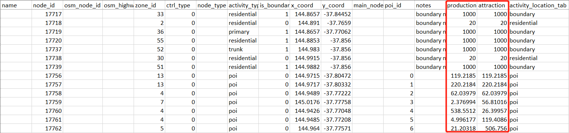
Step 5: Define production/attraction values of each node according to the node’s activity type
Three kinds of nodes in the network can generate travel demand: 1) POI nodes, 2) residential nodes, and 3) boundary nodes.
Users can customize production and attraction values of residential nodes and boundary nodes.
A sample of updated node.csv
Notes:
There are three kinds of nodes can generate travel demand.
The values of production and attraction of each POI node are calculated according to land use type, trip purpose and the area of the building (or other unit of measurement).
For residential nodes and boundary nodes, users can directly customize the production and attraction values.
In step 5, the values of production and attraction of each node are obtained.

Slide 23
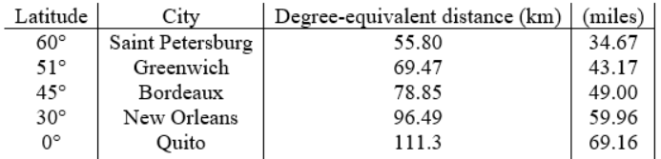
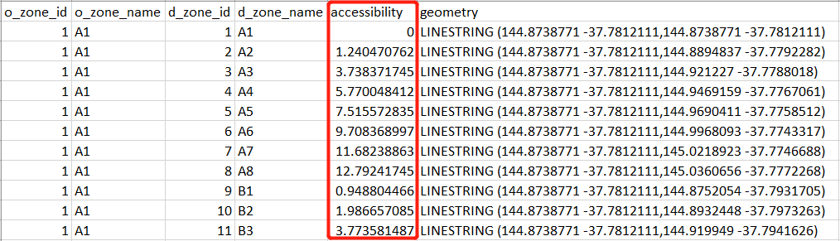
Step 6: Calculate zone-to-zone accessibility
A degree at different latitudes represents different lengths on a flat surface. Users need to input the latitude of the area of interest for converting x/y coordinates into
lengths on a flat surface.
Currently, accessibility is measured by straight-line distance between zone centroids.
A sample of accessibility.csv
Notes:
Next step is to calculate accessibility. A degree at different latitudes represents different lengths on a flat surface. We need to convert x/y coordinates into lengths on a flat surface. According to the input latitude of the area of interest, equivalent length will be used in the tool.
Currently, accessibility is measured by straight-line distance between zone centroids. Later, we’ll calculate realistic travel distance with a Shortest Path Algorithm.

Slide 24
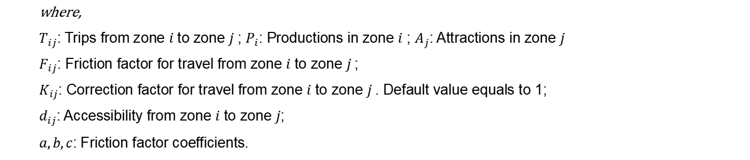

Step 7: Apply gravity model to perform trip distribution
For each OD pair, a typical gravity model is applied to calculate zone-to-zone demand volume.
$$T_{ij}=P_{i}∙\frac{A_{j}∙F_{ij}∙K_{ij}}{\sum_{j}{\left(A_{j}∙F_{ij}∙K_{ij}\right)}}$$
$$F_{ij}={{a(d_{ij})}^{b}e}^{c(d_{ij})}$$
where,
$T_{ij}$: Trips from zone $i$ to zone $j$; $P_{i}$: Productions in zone $i$ ; $A_{j}$: Attractions in zone $j$
$F_{ij}$: Friction factor for travel from zone $i$ to zone $j$;
$K_{ij}$: Correction factor for travel from zone $i$ to zone $j$. Default value equals to 1;
$d_{ij}$: Accessibility from zone $i$ to zone $j$;
$a,b,c$: Friction factor coefficients.
Trip Purpose | a | b | c
1 (HBW) | 28507 | -0.02 | -0.123
2 (HBO) | 139173 | -1.285 | -0.094
3 (NHB) | 219113 | -1.332 | -0.1
Default values of friction factor coefficients under a specific trip purposes
Notes:
Finally, a typical gravity model is utilized to get zone-to-zone demand volume.

Slide 25
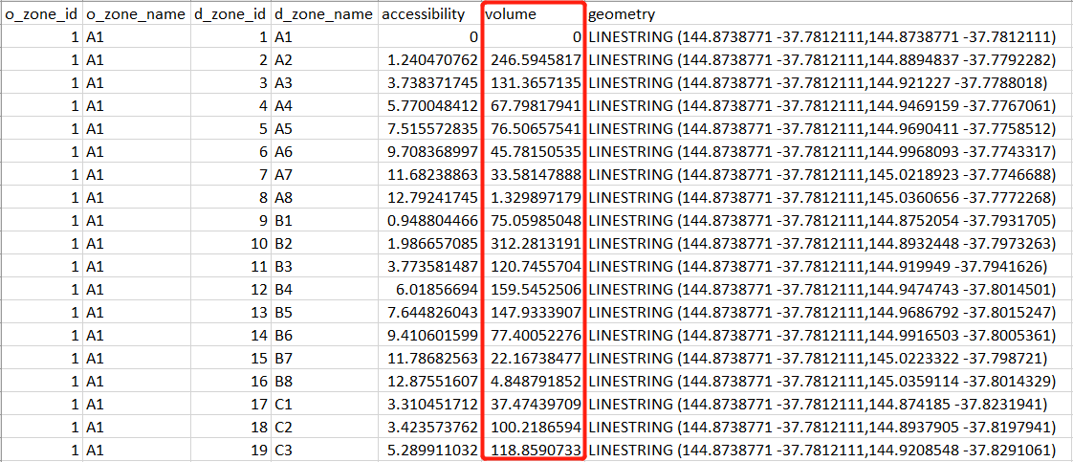
Step 7: Apply gravity model to perform trip distribution
Users can specify a trip purpose to use default coefficients or customize friction factor coefficients.
A sample of output demand.csv
Notes:
The coefficients of friction factor function can use the default values under a specific trip purpose or customize as well.

Slide 26
Visualization
All features are stored with geometry (i.e. x/y coordinates). It’s readily to visualize the output demand.csv and other features in QGIS.
Notes:
Due to all features stored in .csv format with geometry field, so it’s easy to visualize the output demand and other features in QGIS.
OK, this is a quick introduction to Grid2demand. Let me show you with an online demo now.

